Slide 1
Heart Disease Prediction and Factors Analysis CSE 841: Project
Presenter: Asadullah Hill Galib

Slide 2
Overview
Predicting heart disease effectively
Important factors/attributes analysis

Slide 3
Scientific Question
How the factors/attributes influence heart disease prediction?
How well can we predict heart disease using machine learning techniques?

Slide 4
Data (Cleveland dataset (UCI)
13 Attributes:
age
sex
chest pain type (4 values)
resting blood pressure
serum cholestoral in mg/dl
fasting blood sugar
resting electrocardiographic results (values 0,1,2)
maximum heart rate achieved
exercise induced angina
oldpeak = ST depression induced by exercise relative to rest
the slope of the peak exercise ST segment
number of major vessels (0-3) colored by flourosopy
thal: 0 = normal; 1 = fixed defect; 2 = reversable defect

Slide 5
Implementation
Python
Jupyter Notebook

Slide 6
Data Exploration & Preprocessing
303 Instances
165 - Heart attack 1
138 – Not heart attack 0
Distribution

Slide 7
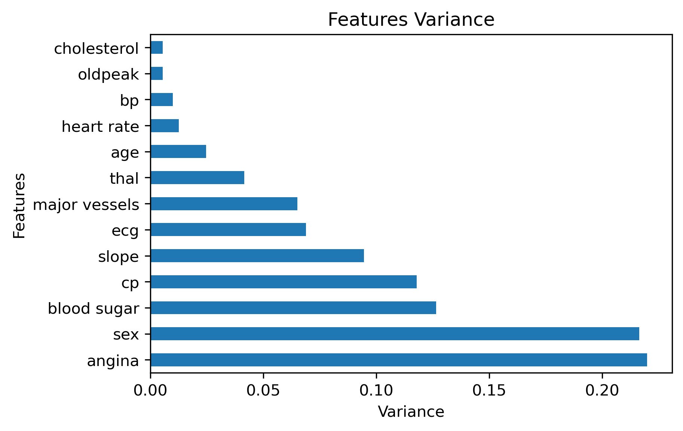
Data Exploration & Preprocessing
Variance

Slide 8
Data Exploration & Preprocessing
Missing Value Treatments
Normalizing
Outliers Imputation
Correlation
Train Test Split
Preprocessing Steps

Slide 9
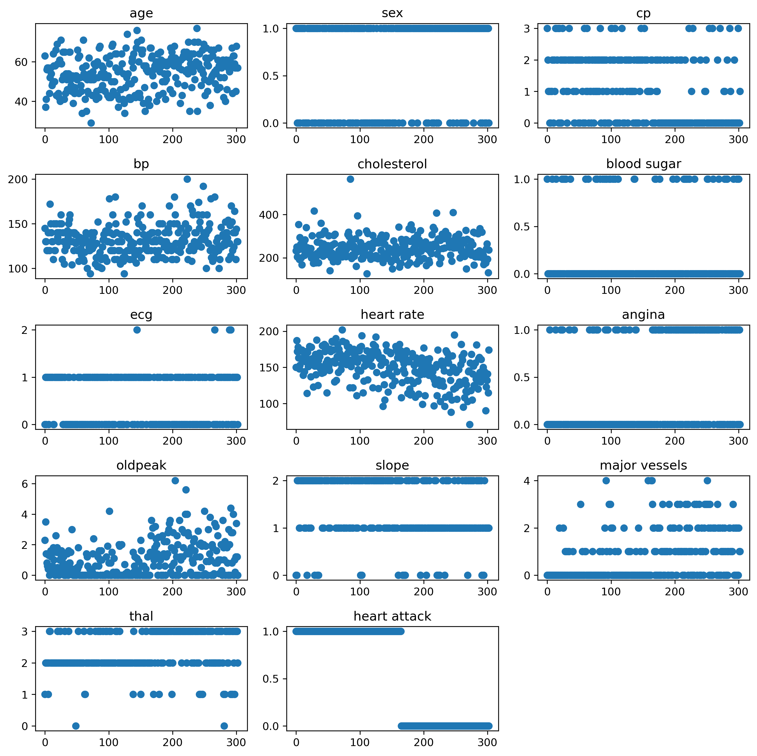
Data Exploration & Preprocessing
Outliers Imputation

Slide 10
Data Exploration & Preprocessing
Using Z-score
Number of outliers:
bp: 8
Age: 2
Cholesterol: 17
Heart rate: 15
Oldpeak: 8
Outliers Imputation

Slide 11
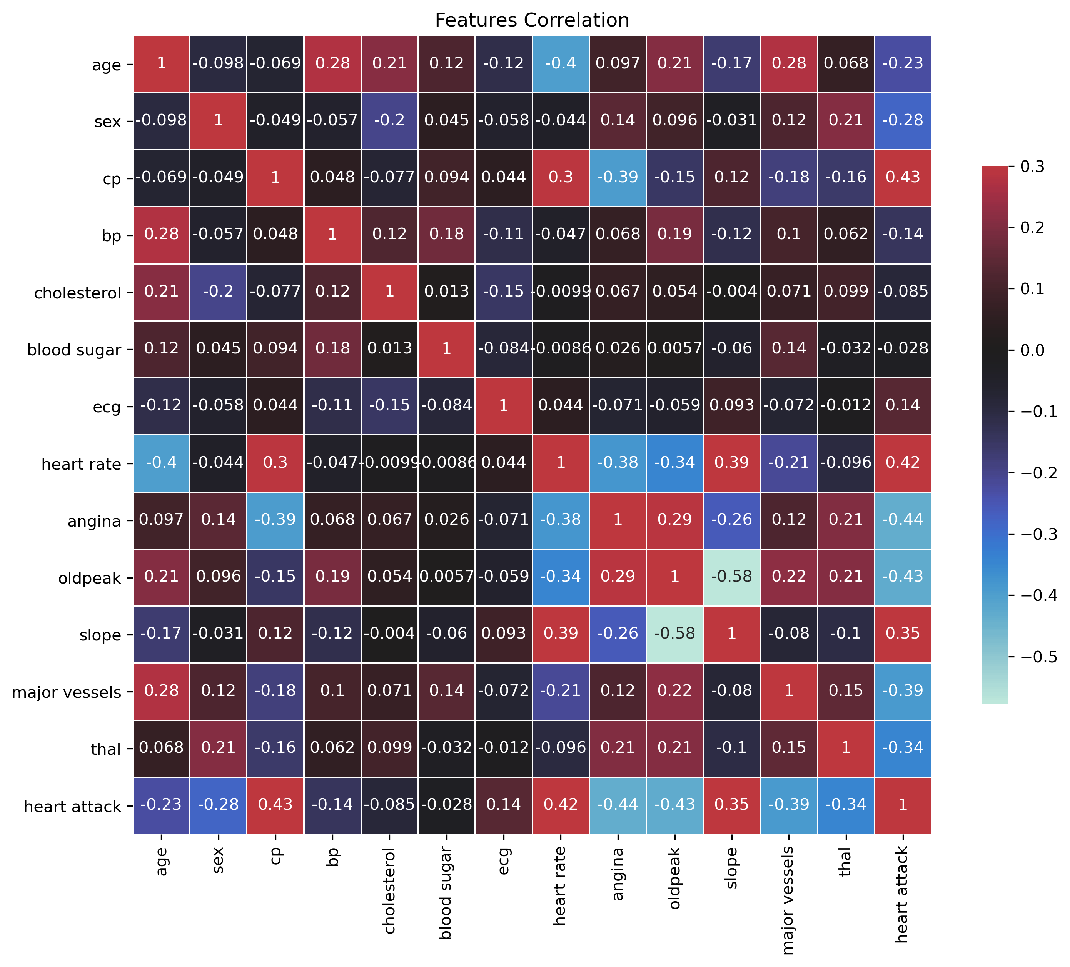
Data Exploration & Preprocessing
Correlation

Slide 12
Important Factors in Heart Disease
Chi Square Test
Random Forest Classifier
Gini Importance
Mutual Information Gain
ROC-AUC
Analysis Techniques

Slide 13
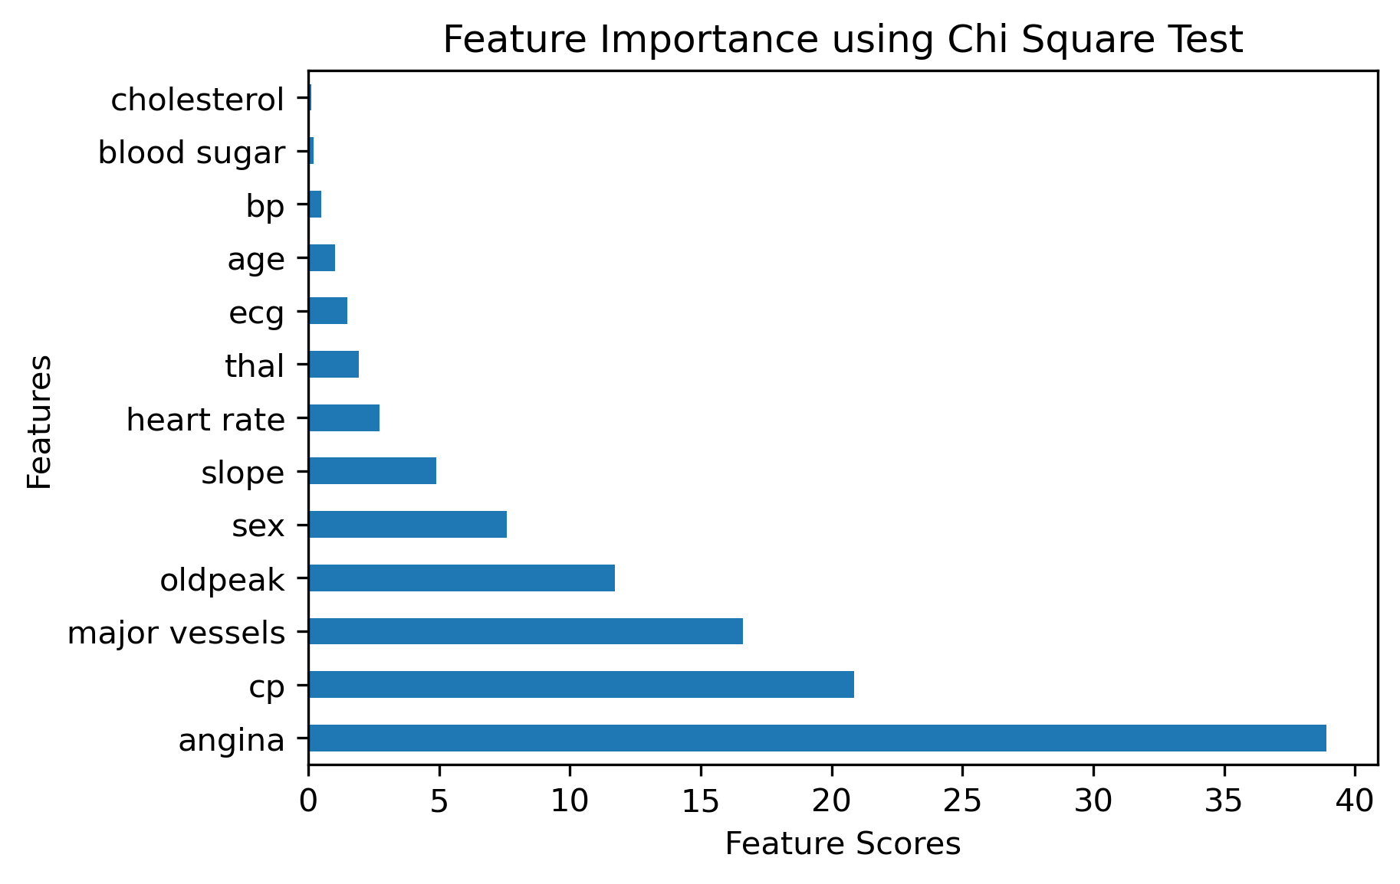
Important Factors in Heart Disease
Chi Square Test

Slide 14
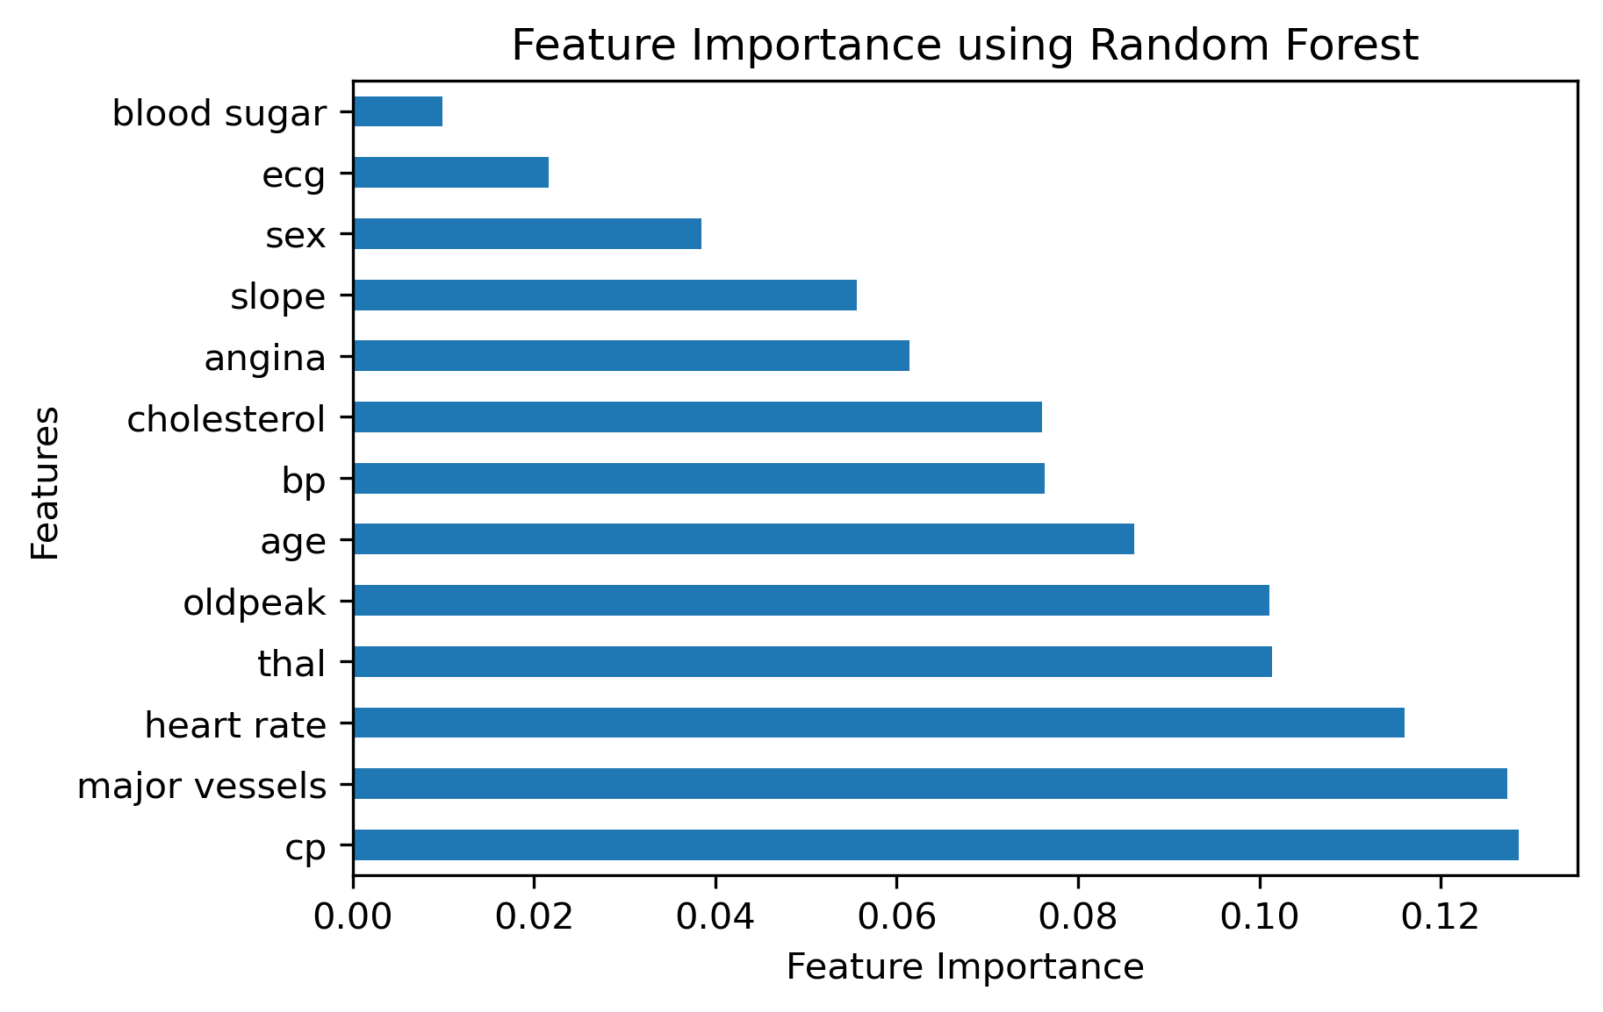
Important Factors in Heart Disease
Random Forest Classifier

Slide 15
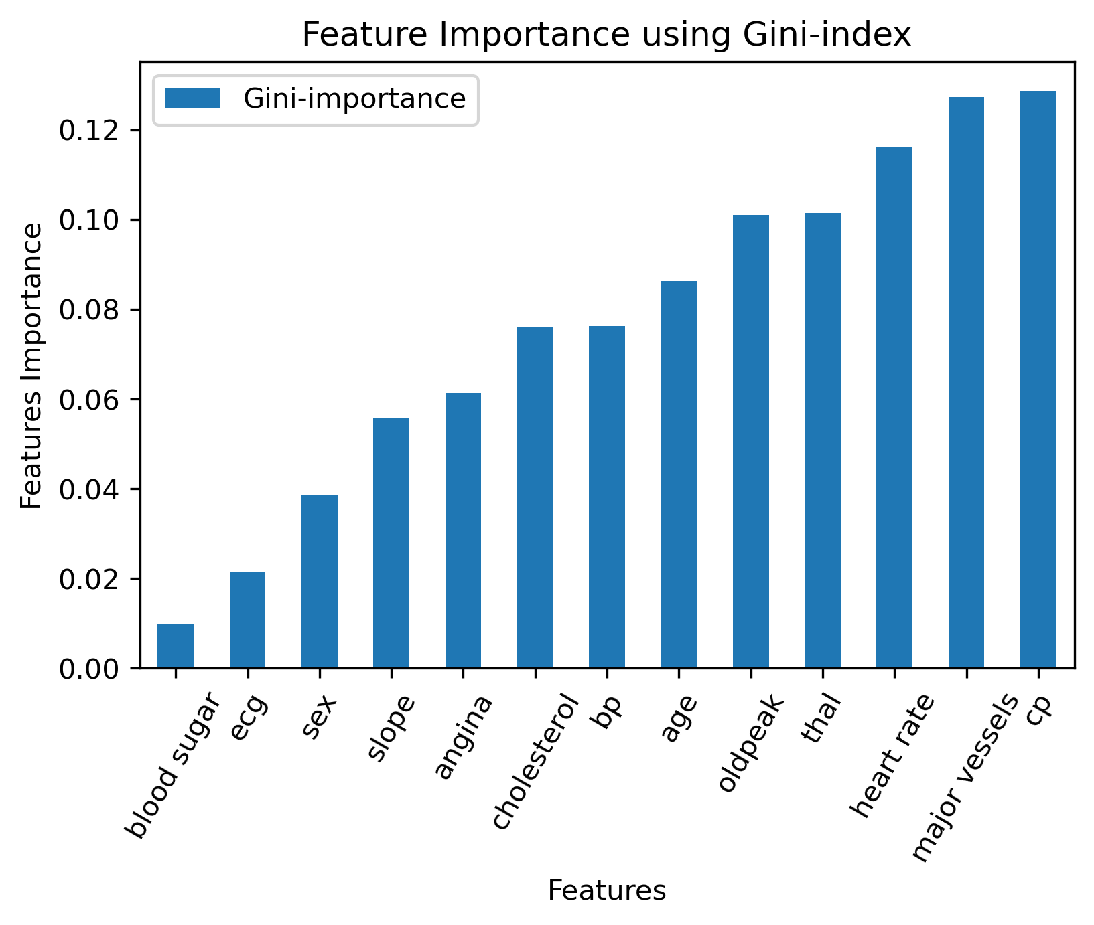
Important Factors in Heart Disease
Gini Importance

Slide 16
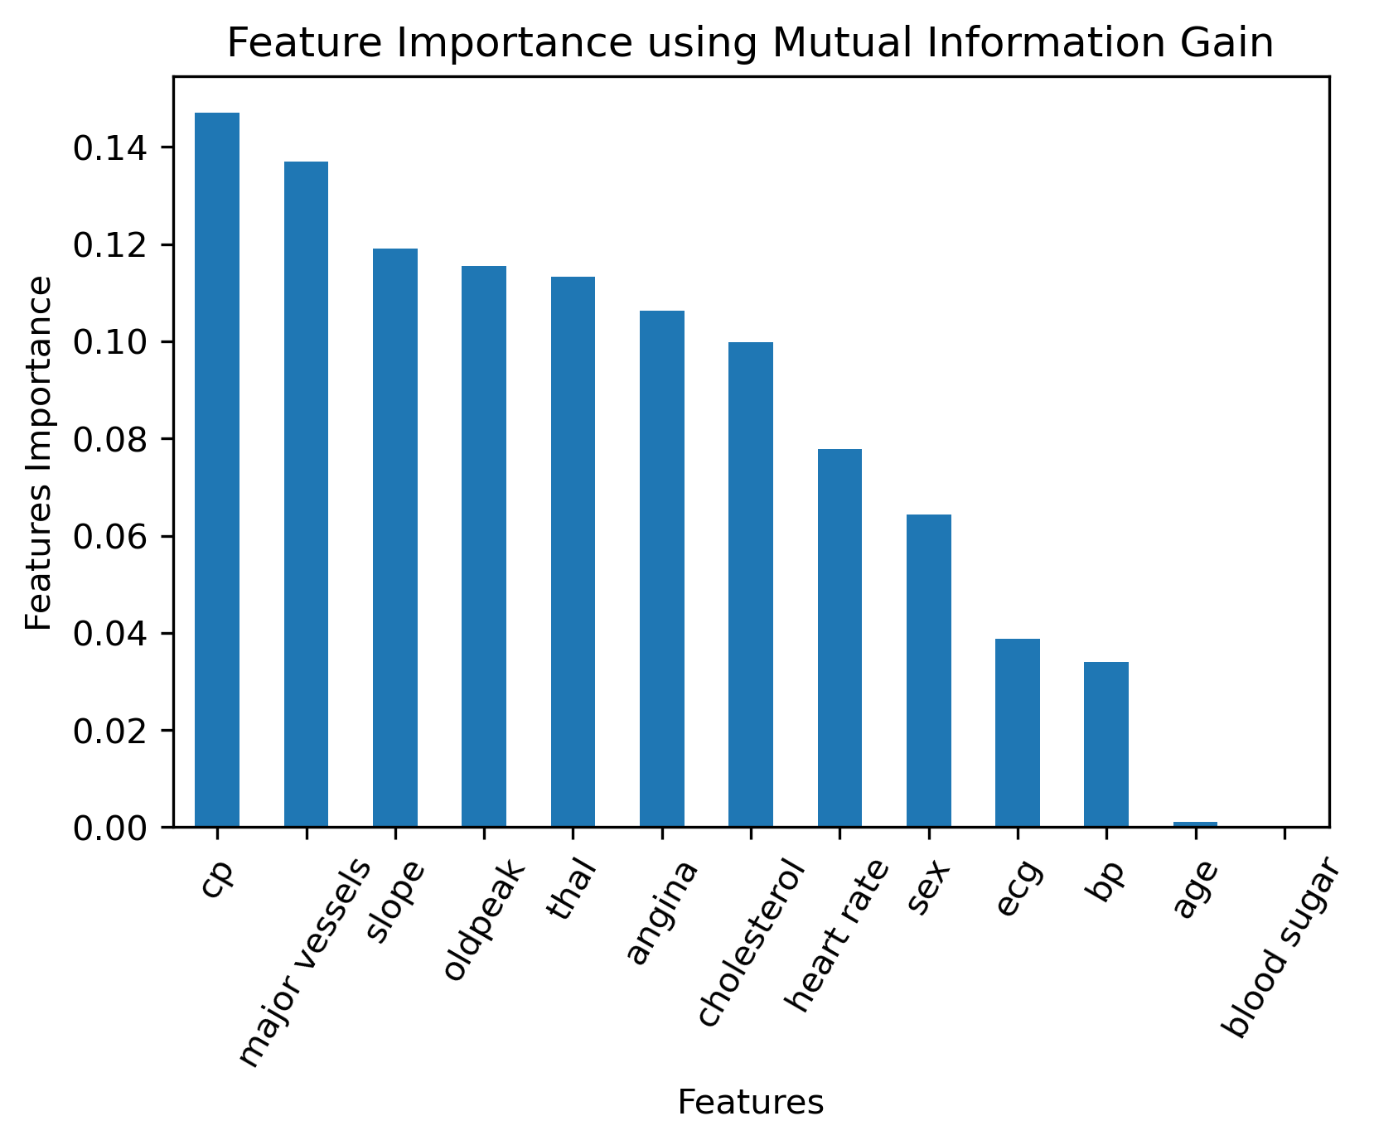
Important Factors in Heart Disease
Mutual Information Gain

Slide 17
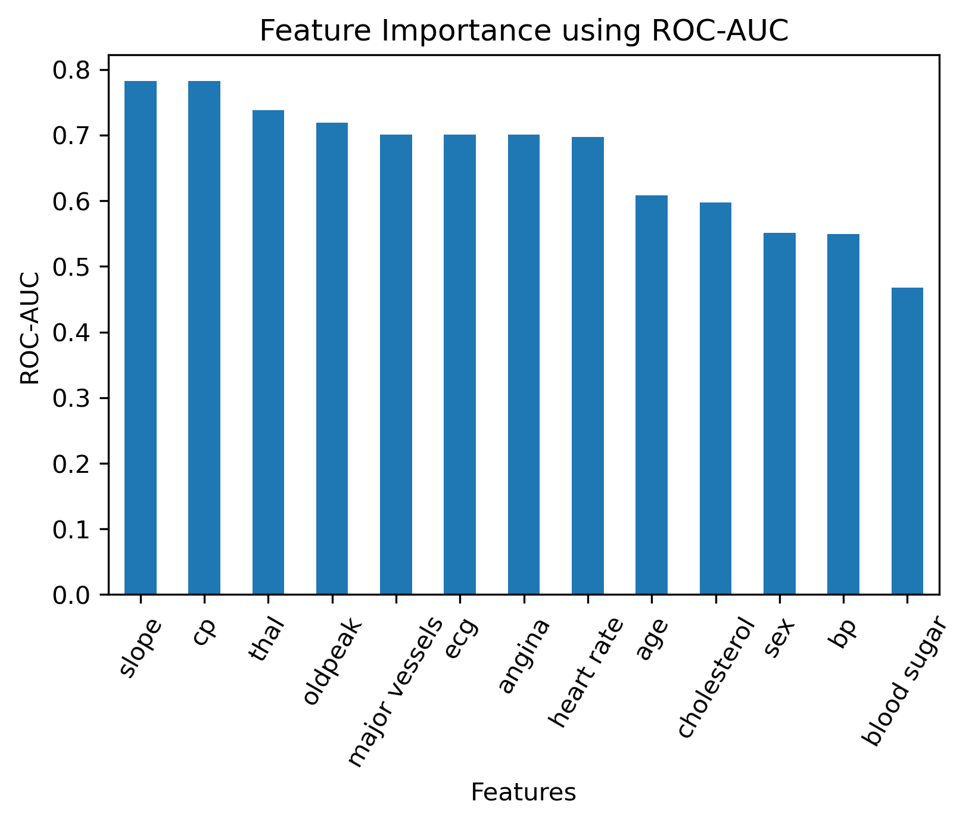
Important Factors in Heart Disease
ROC-AUC

Slide 18
Important Factors in Heart Disease
Top:
Cp
Major vessels
Slope
Thal
Oldpeak
Bottom:
Blood Sugar
Sex
Ecg
Conclusion

Slide 19
Predicting Heart Disease
Random Forest
Support Vector Machine
KNN
Decision Tree
Extra Trees
Naïve Bayes
Logistic Regression
Gradient Boosting
AdaBoost
Linear Discriminant Analysis
Principal Component Analysis (PCA)
Stacking Classifer
Machine Learning Algorithms

Slide 20
Predicting Heart Disease
Support Vector Machine: Kernel = linear, RBF, polynomial; C =1
KNN: Neighbors = 2~7
Decision Tree: Entropy-based, Gini-based
Logistic Regression: Penalty = l2, l1, linear
Principal Component Analysis (PCA): Components: 2~8
Stacking Classifier: Extra Trees, Random Forest, and Logistic Regression
10-Fold Cross Validation
Algorithms Parameters

Slide 21
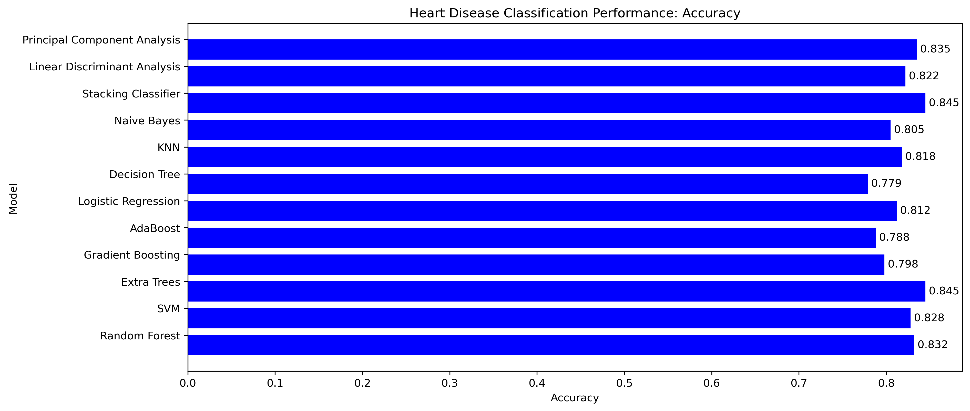
Predicting Heart Disease: Accuracy

Slide 22
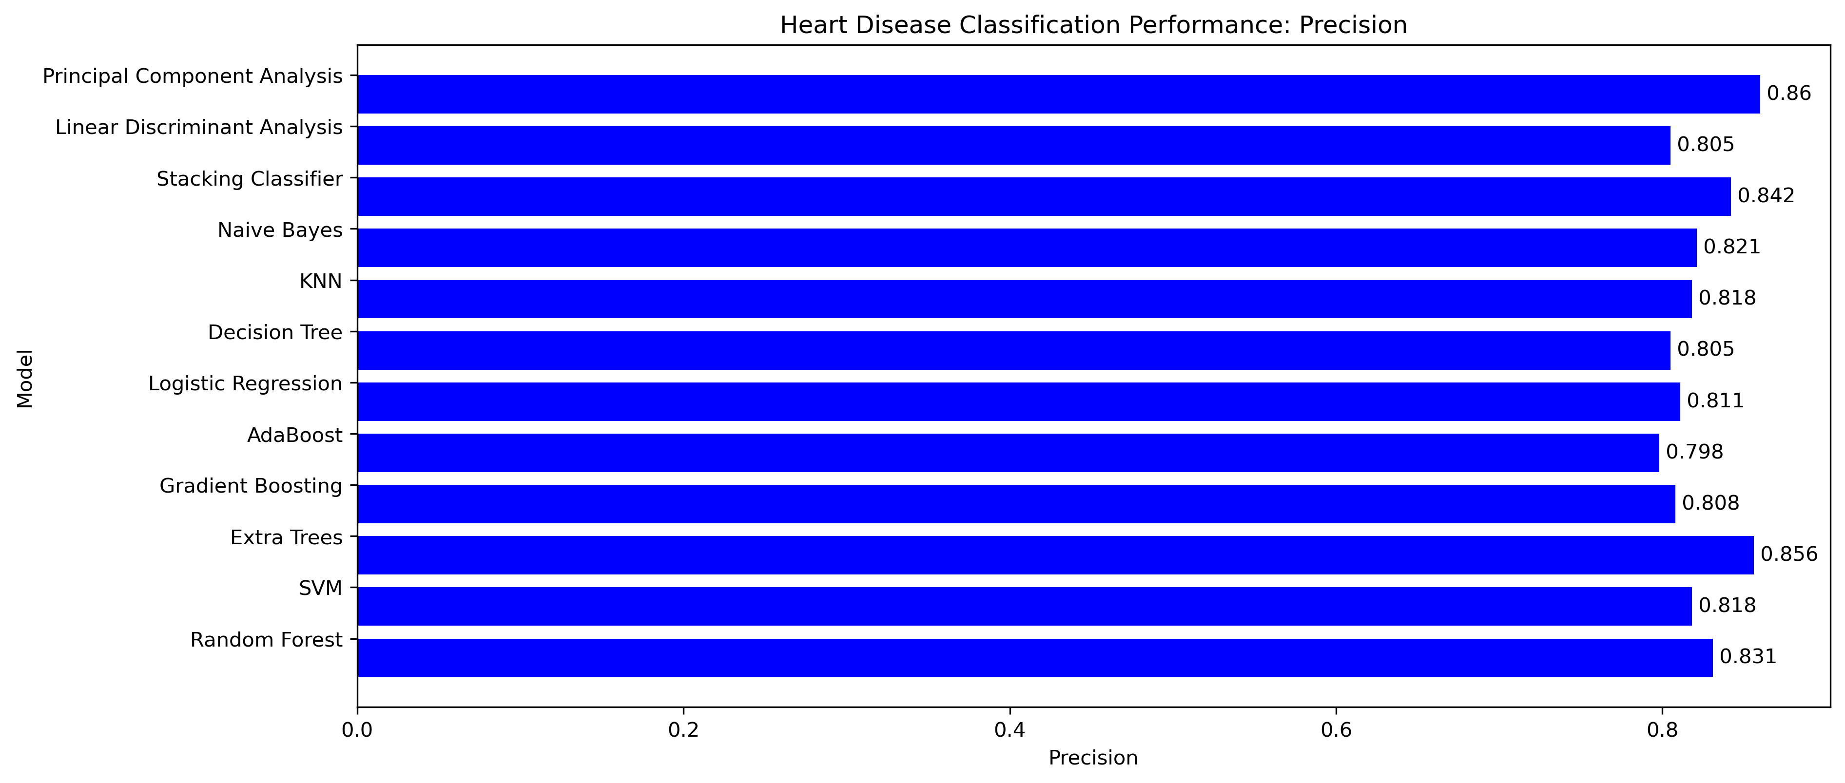
Predicting Heart Disease: Precision

Slide 23
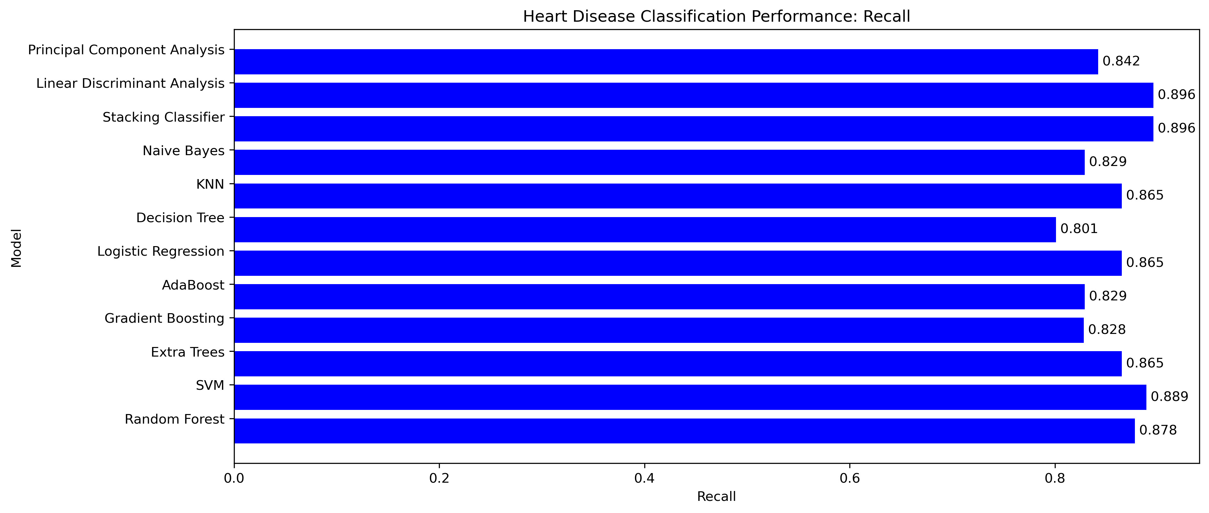
Predicting Heart Disease: Recall

Slide 24

Predicting Heart Disease: F1-Score

Slide 25
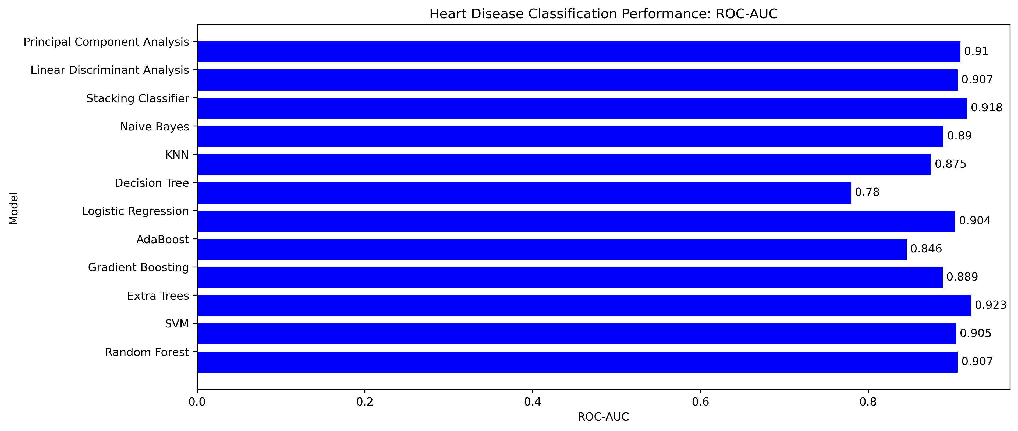
Predicting Heart Disease: ROC-AUC

Slide 26
Predicting Heart Disease
Top Classifiers:
Extra Trees
Stacking Classifier
Support Vector Machine
Random Forest
Principal Component Analysis (PCA)
Conclusion

Slide 27
Conclusion
Genetic Algorithm and Neural Network based learning
Feature learning

